Slide 1
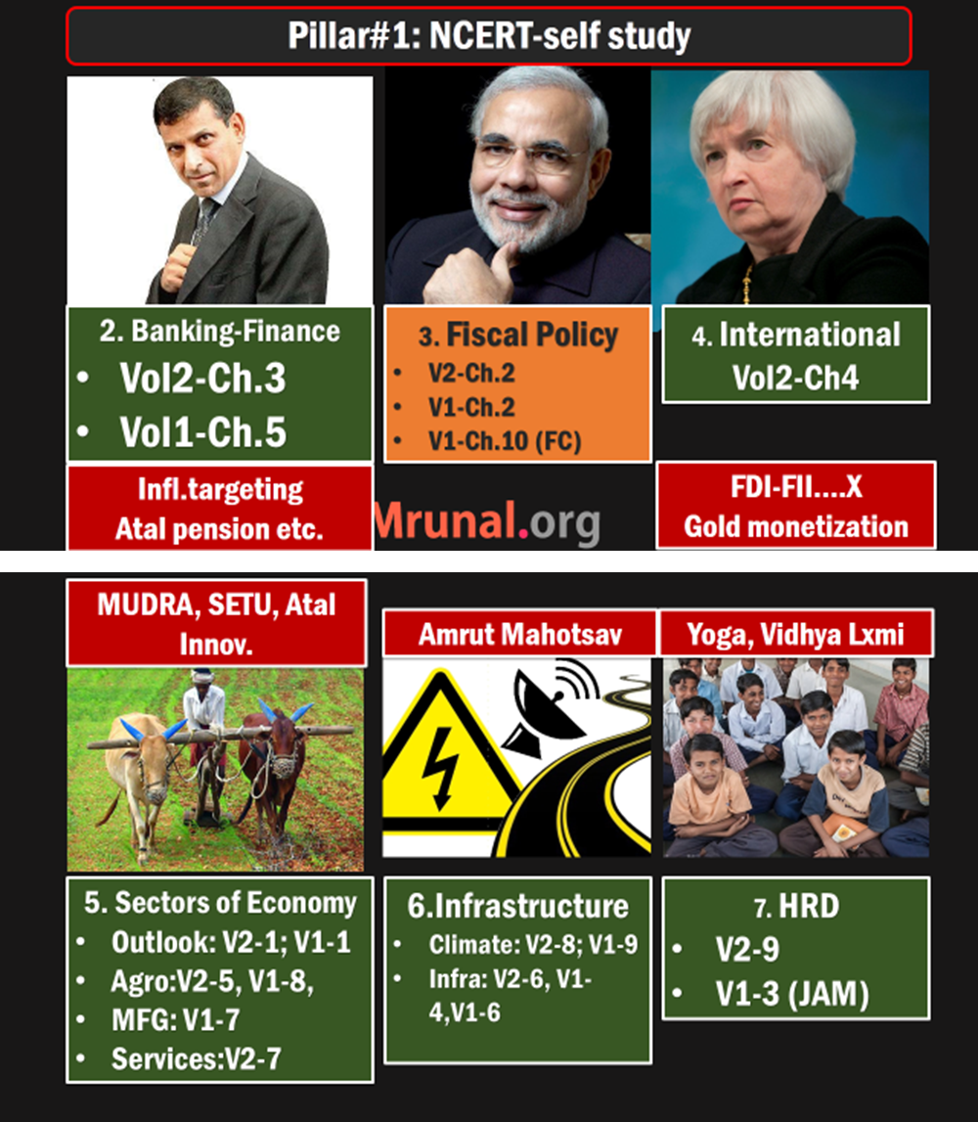

Slide 2
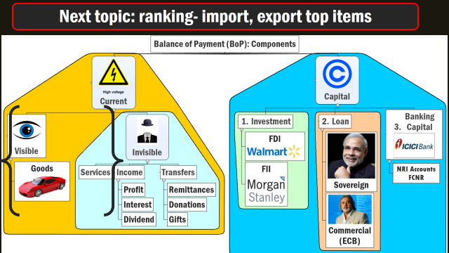
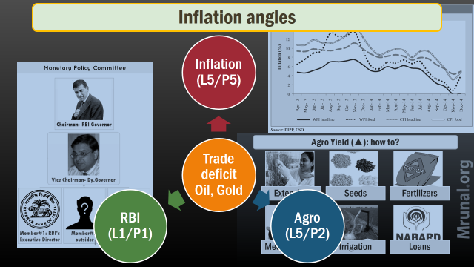

Slide 3
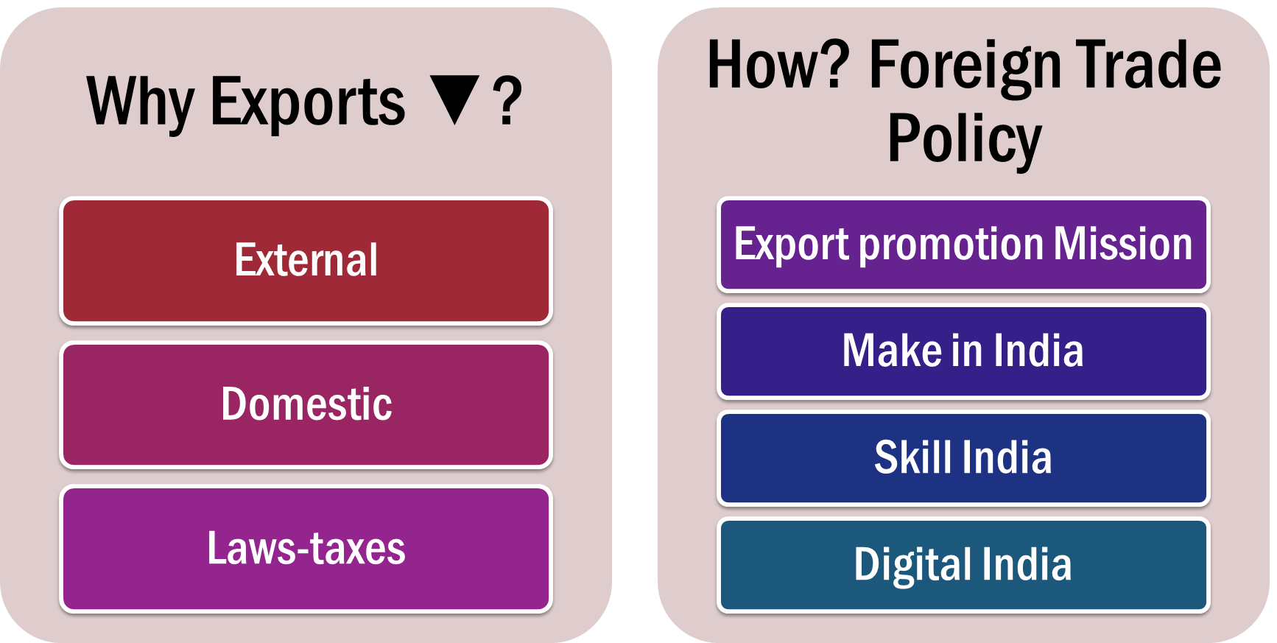
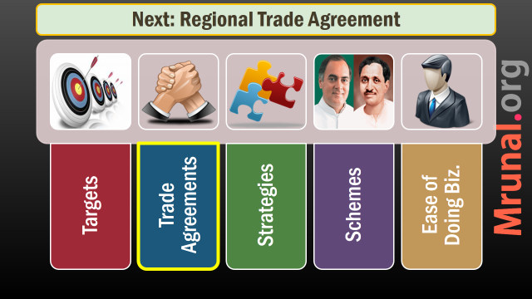
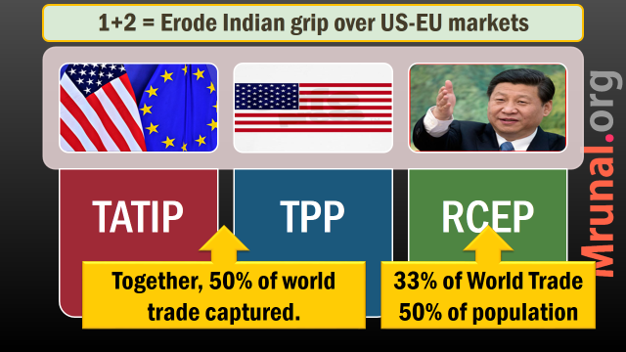
FTP-2015 to boost EXPORT

Slide 4
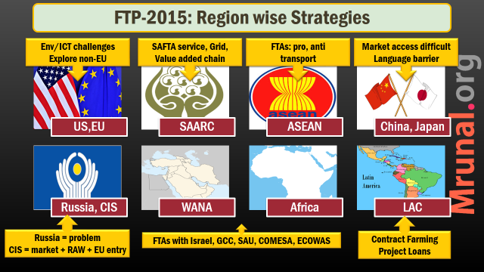
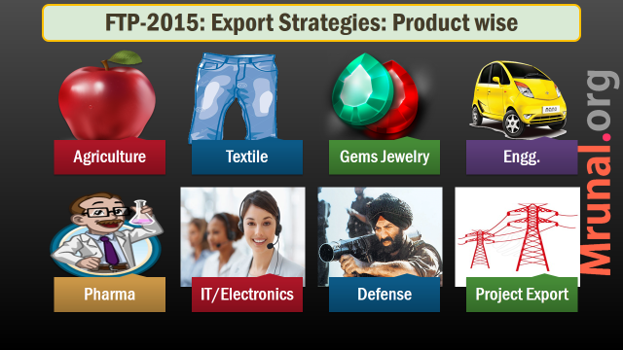

Slide 5
FTP-2015: Export Strategies: Product wise
Engg.
IT/Electronics
Defense
Agriculture
Textile
Gems Jewelry
Project Export
Pharma

Slide 6

Agriculture Export
FTP-2015
Inflation, food security
On / off export policy…x
Open export policy….yes
Post harvest, cold storage, farm2port connectivity
SPS: stringent quality norms in Advance. E.g only APEDA certified exporters can send Mangoes
Notes:
રાંડ્યા પછી નું ડહાપણ ખોટું.

Slide 7


Organic farming
Plantation
Premium market in Jap, EU, USA
Promote more in NE
Sikkim declared as “Organic state”
>50lakh Indians, 50% women
Tea Productivity stagnant, Pesticide limit issues, Kenya compete
Coffee: pest attack = R&D
Rubber Expand to Odisha, Maharashtra, Chhattisgarh, JHK.

Slide 8
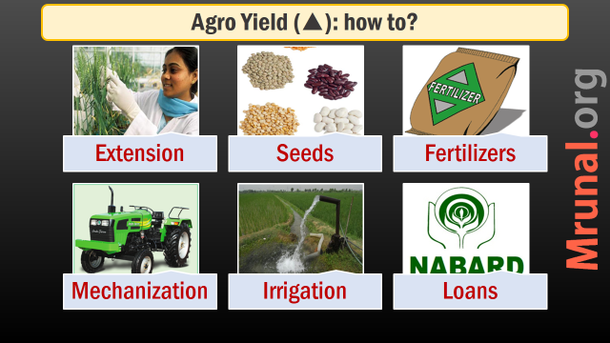
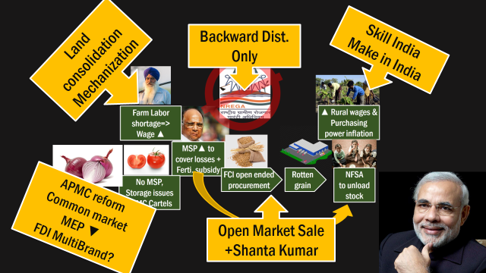
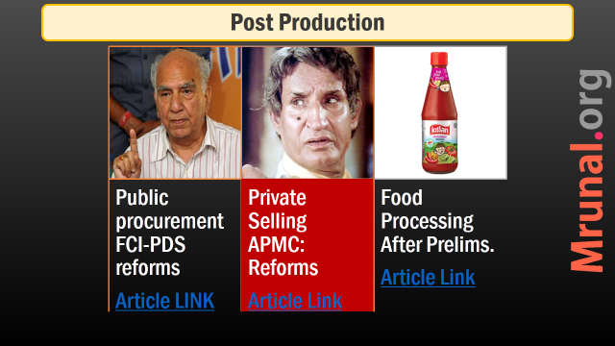
L5/P2.pptx
Organic farming, rubber plantation
Infra./ quality testing/ SPS

Slide 9

Textile
FTP-2015
Light Manufacturing Sectors: leather products and textiles
4.5 crore employed directly
cotton yarn export- advantage over China and Bangladesh
But need to move up the value chain (CMLV, Make outside India)
Product diversification in garments: women garments, synthetic textiles.

Slide 10

Gems Jewelry
FTP-2015
35 lakh employed
Mostly SME but need high capital (Mudra L5/P3.pptx)
80:20 gone (L6/P1.pptx)
Gold monetization scheme to help
Pact with Russian company, to import raw diamonds directly.
Problem: (1) PAN Card for >1 lakh (2) 10% custom duty on gold.

Slide 11
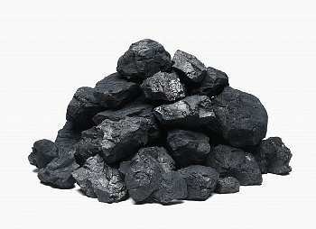
Mining
FTP-2015
export decline because
Ban on iron ore mining
Coal scam
Environment clearance problem
Make in India: more consumption expected @home.
To increase production, Coal and MMDR Bills (L7/P2.pptx)

Slide 12
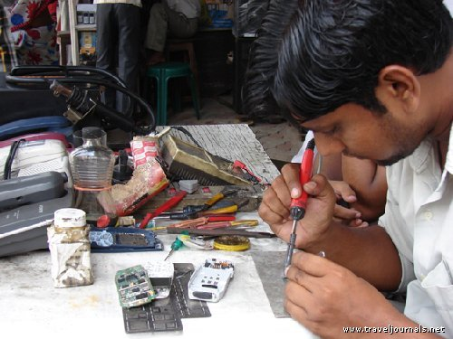
MSME
FTP-2015
45% MFG output
40% export
8% GDP.
6000 products
Budget 2015: Mudra, Atal, Setu (Ref. L5/P3.pptx)
FTP: Provide interest subvention for 3 years

Slide 13
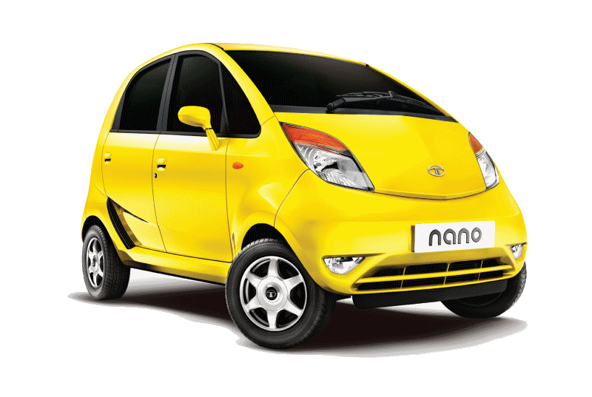
Engineering
FTP-2015
China: 12% of world export
India: hardly 1.2%
Low technology, high price
MSME designed product = no R&D
Small size car to Africa and WANA
The auto sector can be integrated with global supply chains.
subsidies and incentives….X
Innovation (AIM), skilling, FDI (Ref. L5/P3.pptx)

Slide 14
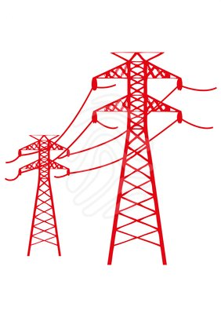
Project export
FTP-2015
Export of goods and services for “infrastructure project” in foreign country
Railway lines & airports
Thermal Power station, electricity grids
Roads and bridges
Dams and canals
Particularly Africa, LAC, SAARC, ASEAN

Slide 15
Project Exports: WHY?
FTP-2015
Long term relationship of the target country with India
Soft diplomacy, High visibility
Repeat orders easier
Spare parts, annual maintenance and servicing contracts, tech upgrades.
=Steady income from export over 5-20 years.

Slide 16
Project Exports: reform?
FTP-2015
Present 5 billion$. Target 25 billion in next 5 years.
Department of Commerce=> National Export Insurance Account (NEIA), to cover project export risks.
Exim Bank loan to project exporter Indian companies.
Cheap credit to target country with conditionality, but Need large forex reserve (L6/P3.pptx)

Slide 17
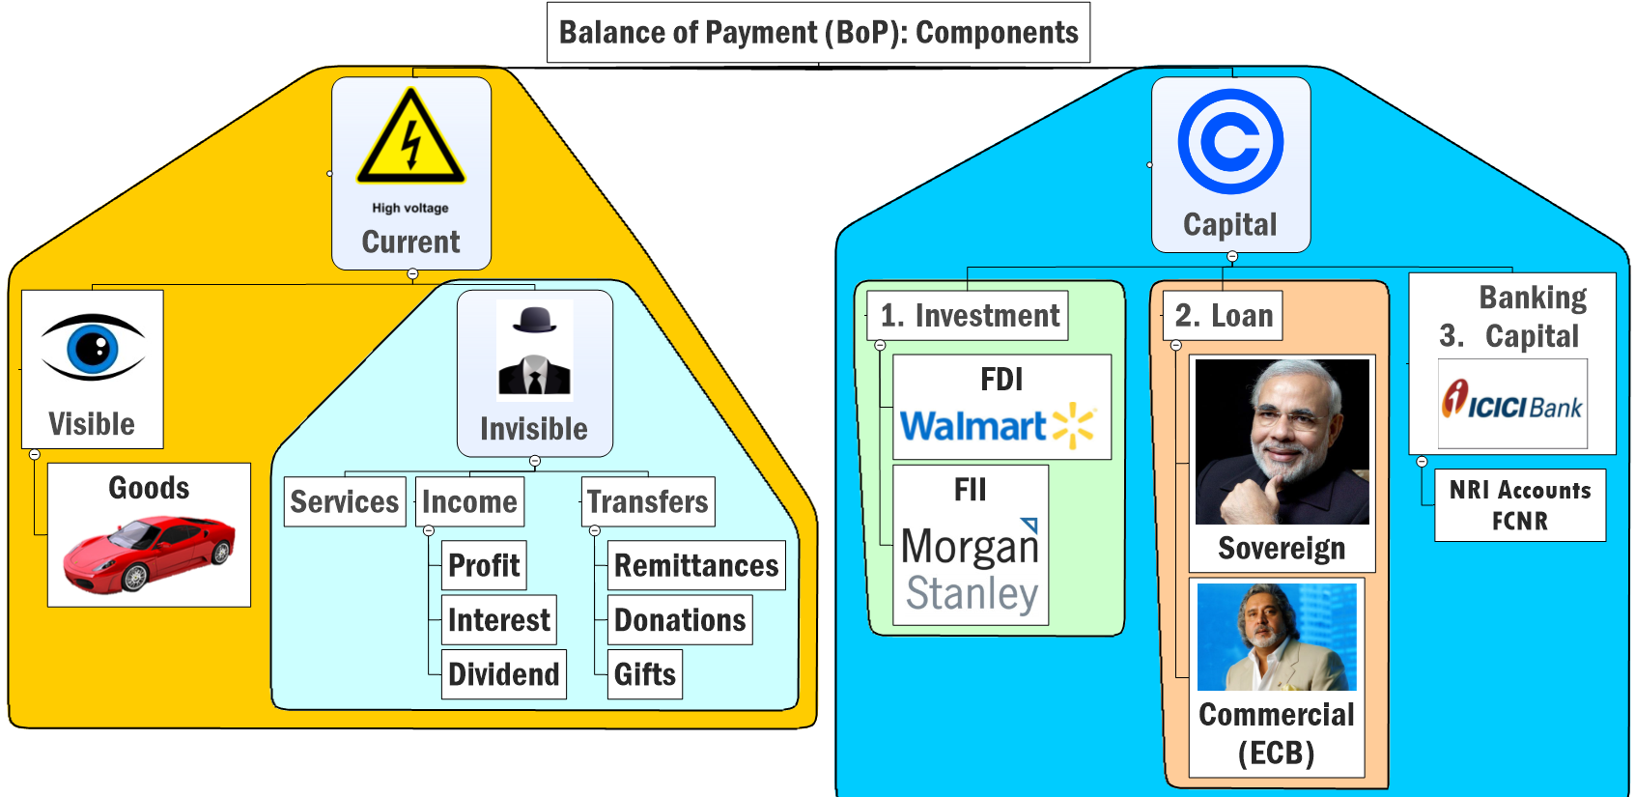
outgoing
incoming

Slide 18
FTP-2015: Export Strategies: Product wise
Engg.
IT/Electronics
Defense
Agriculture
Textile
Gems Jewelry
Project Export
Pharma

Slide 19
Make in India: 5 Pillar Strategy
Simplify Processes
Focus 30 Sectors
Open New Sectors (FDI)
Infra. ▲
IPR protection

Slide 20
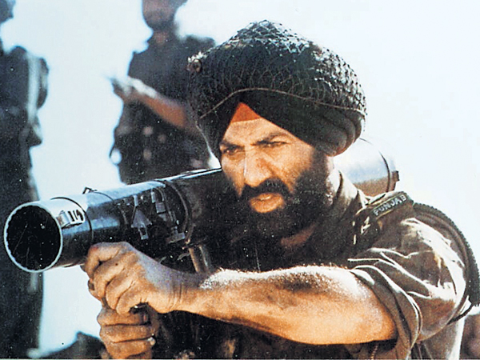
Open New sectors FDI
Make in India
49% govt. approval
Single Indian needn’t have 51%
51% If tech transfer
100% If new tech. involved
No lock in period for investment. (Earlier 3 year)
Insurance=> later in Banking-fin lecture
Notes:
Earlier 3 years loc
The Reserve Bank of India has notified the government's decision to increase foreign investment ceiling in defence sector and of permitting 100% FDI in railways infrastructure. After assuming power, the NDA government has reviewed Foreign Direct Investment (FDI) policy for railways sector as well as defence.
While, the government permitted 100% FDI in railway infrastructure sector under the automatic route subject to conditions, in defense sector, it has permitted foreign investment (FDI, FIIs, RFPIs, NRIs, FVCIs and QFIs) up to 49% under government route (FIPB).
The earlier cap for the sector was at 26%. As per the revised policy for defense sector, portfolio investment (RFPI/FII/NRI/QFI) and FVCI investment will not exceed 24% of the total equity of the investee company.
Meanwhile, as per the policy for railway sector, FDI beyond 49% of the equity of the investee company in sensitive areas from security point of view will be brought before the Cabinet Committee on Security (CCS) for consideration on a case to case basis.
k in period.

Slide 21


PRO FDI Defense
Anti
Desi PSU, DRDO failed
Private companies more efficient & finish in deadline
Tech transfer= self reliance in long term.
MNCs not doing in tech transfer unless “repeat orders” assured
30% offset requirement

Slide 22
Defense
FTP-2015
Offset Mechanism: foreign suppliers have to buy/invest at least 30% of total value in India.
Needs relooking under Make in India

Slide 23
FTP-2015: Export Strategies: Product wise
Engg.
IT/Electronics
Defense
Agriculture
Textile
Gems Jewelry
Project Export
Pharma

Slide 24

Electronics
FTP-2015
Compared to China, Taiwan, Korea and Japan……India has:
High taxation
Electricity, loan, transport expensive
End result:
Indian electronics 8-10% expensive than other.
Export competitiveness Lost.
Even Indian demand met by imports

Slide 25
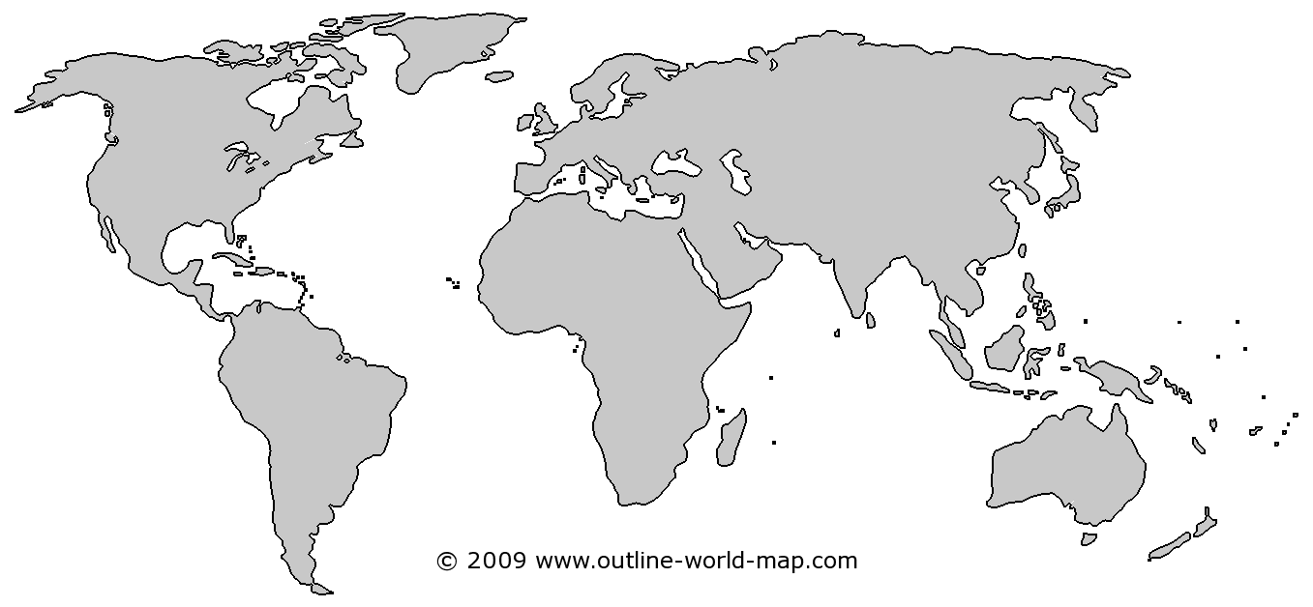
ICT: single largest contributor to India’s serve exports
20%
60%
can’t go
Unique language
Market req.
Focus here to counter US/EU slowdown
Notes:
from >100 per barrel to <50$
China, EU Growth▼=oil demand ▼
US oil + shale gas production ▲
OPEC oligopoly ▼, S.Arabia did not ▼ production
Survey predicts: $60-65 / barrel, so, inflation and CAD will be moderate for 2015-16

Slide 26

IT/ITES
FTP-2015
E-Commerce, Cloud Computing, Mobile Applications
Also explore Healthcare, education, R&D, consultancy,
Printing, publishing and entertainment services

Slide 27
Services issues
FTP-2015
healthcare, education: deceptive practices
Must enforce minimum standards e.g. wellness centres claiming to be Ayurvedic / yoga centres.
Global exhibition for all types of services
Help big players meet Indian startups.
Notes:
Singapore philipines will take advange of it.

Slide 28
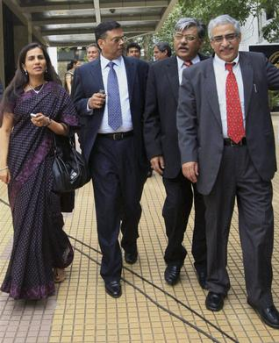
MICE
FTP-2015
Meetings, incentives, conventions, exhibitions (MICE)
300 billion market. India hardly 1%
Pragati Maidan, Delhi – alone not sufficient.
Need convention infrastructure, even in tier1, tier2 cities.

Slide 29
FTP-2015: Export Strategies: Product wise
Engg.
IT/Electronics
Defense
Agriculture
Textile
Gems Jewelry
Project Export
Pharma

Slide 30
Sci-Tech side topics
Glivec, Nexvar
BRCA Gene Patenting
3 Parent Baby

Slide 31




Gene Patenting (2015, March)
US-SC: Myriad did not invent “Gene” (2013)
but Aussie SC upheld gene-patenting valid (2014)
BRCA1,2 Genes
Cancer
Chance ~16-60%
Myriad Genetics
90s: patented the gene
~$3000 test
Family history, defective BRCA genes
Removed breasts, ovaries, fallopian tubes

Slide 32


3 parent baby (feb 2015 UK legalized)
Donor Lady
Mitoc. DNA (healthy)
Mother: Egg
Mitochondria DNA (if defective)
father
sperm
Mitochondria: powerhouse of the cell,
if defective “muscular dystrophy”– no cure available

Slide 33
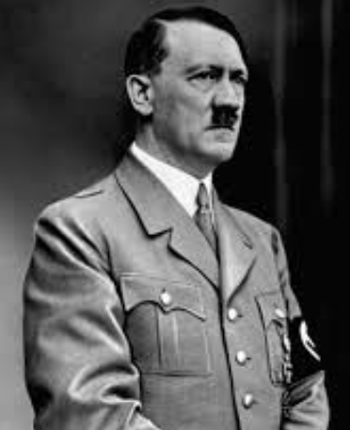
Nazi Holocaust
Eugenics
Eugenics: improve human race through “controlled” breeding.
Hitler wanted to create Super Aryan race through Eugenics
Gas chamber: Jews, Gypsies, physically disabled.
Genetic engineering => designer babies => social exclusion of others.

Slide 34


Swiz.Novartis – won’t invest in Indian drug R&D
Glivec: blood/GI cancer
1.2 lakh / month
Generic drug
8000 / month
Patient expires @20 years
Slight alteration in chem.structure, to get new patent
SC says Evergreening invalid
Imatinib Mesylate
Notes:
Glivec already patented in more than 30 countries. So this is not a case of evergreening.
We provide free medicine to needy patients.
If drug inventions are not protected, then pharma companies will lose the incentive to invest more time and money in research and Development of new drug molecules = in long term it’ll have negative consequences when the virus/bacteria will become resistant to existing drugs.
After the defeat in supreme court, Novartis said they will not invest in drug research in India anymore.

Slide 35
German Co. Bayer Pharma
Nexvar: Liver/Kidney cancer
Rs.2.5 lakh/120 tabs
DG Patent
NATCO, Hyd.
Generic drug
Rs.9000 /120 tabs
Pay 6% Royalty
Notes:
Glivec already patented in more than 30 countries. So this is not a case of evergreening.
We provide free medicine to needy patients.
If drug inventions are not protected, then pharma companies will lose the incentive to invest more time and money in research and Development of new drug molecules = in long term it’ll have negative consequences when the virus/bacteria will become resistant to existing drugs.
After the defeat in supreme court, Novartis said they will not invest in drug research in India anymore.

Slide 36
Sci-Tech side topics
Glivec, Nexvar
BRCA Gene Patenting
3 Parent Baby

Slide 37

Pharma Strength
FTP-2015
3rd Rank globally
10% of global trade
Grip over Generics, Affordable to third world.

Slide 38
Pharma challenges
FTP-2015
Approval to sell in China: need 3-4 years
Chinese drug regulator asks for detailed mfg. process, perform new clinical trials again in China.
Bad media publicity of poor quality of Indian drugs esp. Ranbaxy (Hidden hand of disgruntled MNCs?)

Slide 39
Pharma Solutions
FTP-2015
Spurious / fake drugs in international market- blamed to India.
1/4/2015: Trace and track policy.
Bar codes to all medicines- expiry date, price, source mfg. etc.
Penalties under Drugs and Cosmetics Act 1940

Slide 40
Pharma Solutions
FTP-2015
India Brand Equity Foundation (IBEF) – a trust by Department of Commerce.
Will run special campaigns for pharma products.
100% FDI permitted in Medical devices – future area for growth.

Slide 41
Branding and promotion
Brand India / GI awareness?
complaints
Branding: how?

Slide 42

measures
branding
Brand India: identifiable parameters e.g. Swiz watches, German optics.
GI: only Tea, Basmati known.
India Brand Equity Foundation (IBEF) a trust under Dept. of Commerce.
Export promotion councils (already present)- to focus on branding.
Powerpoints, posters, ad campaigns
Press brief, social media
Notes:
Revamping trade sites

Slide 43
complaints
Branding
Quality testing bodies: “Certified Once, Accepted Everywhere”.
Defective / substandard products
Deadline not met
New body: ‘Committee on Quality Complaints and Trade Disputes’ (CQCTD)
22 offices, 3 months deadline
Reconciliatory. Otherwise victim free to approach courts.

Slide 44
complaints
Branding
Under Export Quality control act 1963 DG Foreign trade can also pursue:
imposing penalty etc.
cancelling registration, removing duty scrip benefits.

Slide 45


Slide 46
Boost Export HOW? = Foreign Trade Policy 2015-20
Strategies
Schemes
Ease of Doing Biz.
Targets
Trade Agreements

Slide 47
Boost exports, reduce rationalize imports
Scrips & schemes
Ease of Doing
Infra.
Taxes
CVD
Dumping
MEIS/SEIS
EPCG
Niryat Bandhu
Inspection
E-Gov.
Status Holder
SEZ
Export houses
TEE, ASIDE

Slide 48
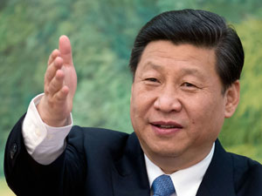
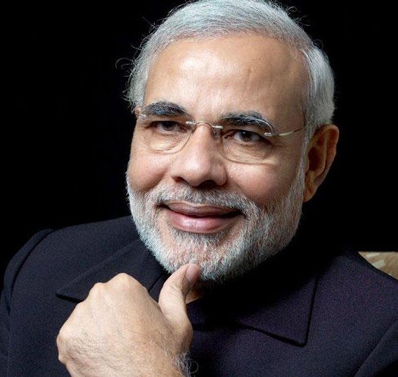
Dumping: selling @lower price in foreign market
4 million tonne
surplus steel
Deliberately sold cheap @India, US, EU
Aim to put $180-300 /ton, anti dumping duty
On Chinese steel
To protect Indian steel makers

Slide 49

Dumping
Imports
Directorate General of Anti-Dumping and Allied Duties (DGAD) – recommends
Under Commerce Ministry
Duty imposed under Custom Tariff Act 1975. (CBEC, FinMin)
Survey: highest # of cases opened in Brazil. Out of them max. against China.

Slide 50
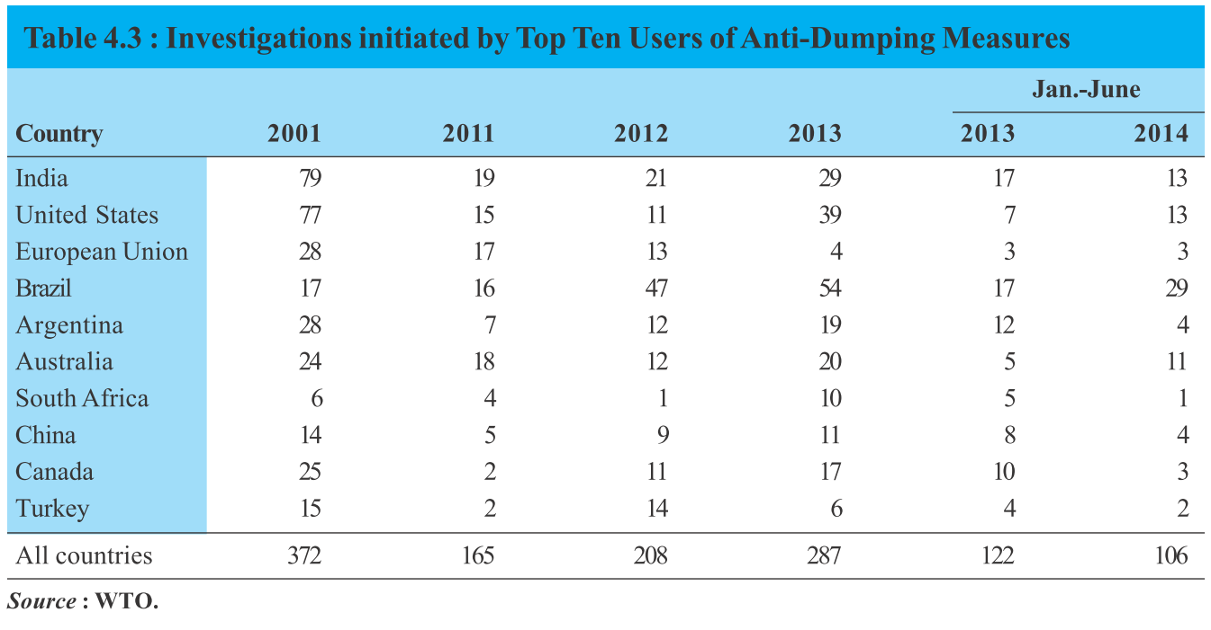

Slide 51
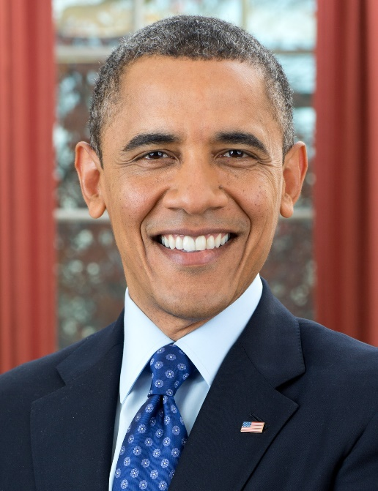
Counter veiling duty (hypothetical example)
$20 CVD on imported solar panel, to give local players equal chance
0% excise
Or subsidy given
US Solar panel cost $100
10% excise
no subsidy given
Indian Solar panel cost $120

Slide 52
Anti Dumping
Counter Veiling Duty (CVD)
Foreign exporter deliberately selling cheaper abroad, than in his home-market.
E.g. Chinese steel.
Subsidies & low taxes by foreign country on their companies.
Vs. high impact of excise duty on lndian mfg. company
CVD on imports To provide level playing field.
Survey: abolish CVD in GST. Imports = custom + IGST
Ref: L4/P4.pptx for more

Slide 53
Boost exports, reduce rationalize imports
Scrips & schemes
Ease of Doing
Infra.
Taxes
CVD
Dumping

Slide 54
FTP-2015: Duty scrip schemes
Before: 5
Focus Product Scheme Focus Market Scheme
After: 2
Merchandise Exports from India Scheme (MEIS).
Market Linked Focus Product Scheme Agri. Infrastructure Incentive Scrip
Vishesh Krishi And Gram Udyog Yojana (VKGUY).
Service Exports from India Scheme (SEIS)

Slide 55



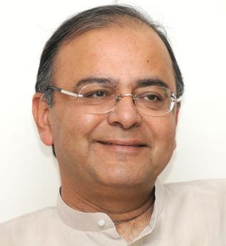
Service export from India scheme (SEIS): 5% scrip
$100
$100
Can use paying Taxes
$5

Slide 56
MEIS & SEIS scrip
FTP-2015
Payment of Customs Duties to import of inputs
Payment of Excise Duties on domestic procurement of inputs or goods.
Payment of Service Tax on procurement of services
Payment other fees.

Slide 57

MEIS not applicable
FTP-2015
SEZ/EOU/EHTP/BPT/FTWZ
Red sanders and beach sand (Environment)
Diamond, Gold, Silver, Platinum (CAD)
Mineral ores (need for Make in India)
Cereals, sugars, milk, meat. (inflation & food security)

Slide 58
MEIS: tea companies unhappy
FTP-2015
Vishesh Krishi and Gram Udyog Yojana (VKGUY): 5% duty credit scrip
Merchandise Exports from India Scheme (MEIS): only 3% duty credit scrip
Kenya & East African tea nations capturing our Russia, CIS, Iran market.
Lobby wants 7%

Slide 59
Boost exports, reduce rationalize imports
Scrips & schemes
Ease of Doing
Infra.
Taxes
CVD
Dumping
MEIS/SEIS
EPCG
Niryat Bandhu
Export promotion capital goods scheme: duty free import of machinery, software, spare parts, catalysts
Handholding New exporters, advanced authorization for raw material import
existing

Slide 60

Border Transport
FTP-2015
State/union agencies will not seize / delay Export consignment. If doubt, ask for undertaking from exporter.
If export stock seized for irregularity - release in 7 days.

Slide 61
Border Transport
FTP-2015
Single window 24/7 custom clearances @18 sea ports and 17 airports.
Faster clearance to agro/perishable produce.
Custom duty: self-assessment permitted.

Slide 62
E-Governance
FTP-2015
Indian trade portal (indiantradeportal.in) : info. on foreign market tax regimes, provisions of trade agreements
http://dgft.gov.in : Exporter importer profile. Once PAN card, registration details, mobile number, email id etc. registered, no need to upload every time. (one type of “DIGITAL LOCKER”)
upload documents by Chartered Accountant / Company Secretary / Cost Accountant
Facility to pay fees /taxes online.
E-BRC (Electronic Bank Realisation Certificate) = faster duty scrip.
Notes:
faster clearance, less transaction cost.

Slide 63
E-Governance
FTP-2015
# of docs. Required for import export
Only 3
Max. Time for clearance
3 months
Cost of import export
reduced

Slide 64
Boost exports, reduce rationalize imports
Scrips & schemes
Ease of Doing
Infra.
Taxes
CVD
Dumping
MEIS/SEIS
EPCG
Niryat Bandhu
Inspection
E-Gov.
Status Holder

Slide 65

Status holder
FTP-2015
India business leaders - goods, services
who have excelled in international trade
Expected to mentor new entrepreneurs
Status recognition depends upon export performance

Slide 66
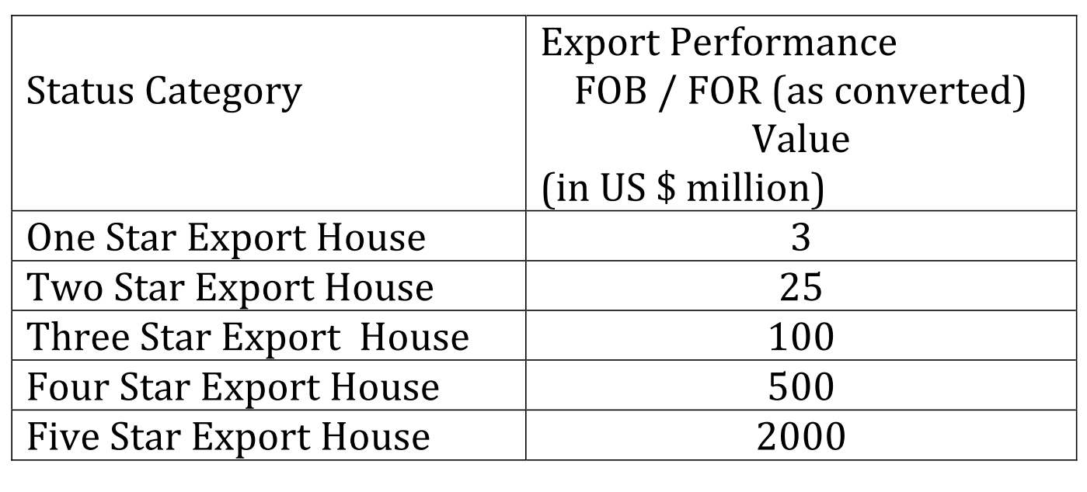
Status holder
FTP-2015

Slide 67
Status holder Benefits of
Preferential treatment and priority in handling of their consignments by the concerned agencies.
Authorization and Customs Clearances for both imports and exports may be granted on self-declaration basis.
self-certify their manufactured goods
Exemption from furnishing of Bank Guarantees / documents
Can setup new export Warehouses.
Preferential treatment: PTA, FTA, CECA related documents.

Slide 68

Involving states
FTP-2015
States asked to form their own strategies for export
State Export commissioner to liaison with union government
Export awards to motivate

Slide 69
Boost exports, reduce rationalize imports
Scrips & schemes
Ease of Doing
Infra.
Taxes
CVD
Dumping
MEIS/SEIS
EPCG
Niryat Bandhu
Inspection
E-Gov.
Status Holder
SEZ
Export houses
TEE, ASIDE
TFA

Slide 70
L3/P4: Latest member: Yemen (2014, June)
WTO Structure
Ministerial Conference
Secretariat
General Council
160 MEMBERS
9th @Bali’13
Every 2 yr
Appoint DG
Trade agreements
10th Nairobi, Kenya’15

Slide 71

THREE Packages
Bali Summit
9th Ministerial, Bali Indonesia, Dec’13
L.D.C. Duty free quota free market access. E.g.No fees on business visa.
Peace clause (L3/P4.pptx)
Trade facilitation agreement (TFA)

Slide 72

Customs Clearance
Trade Facilitation Agreement (TFA)
Bali Summit,
Dec 2013
To be Effective from 2015
BEFORE
AFTER
BENEFIT?
Apply, pay fees/taxes Online
Single window for docu.-check
Faster clearance to perishable goods
No middlemen/agent needed
Coordination bodies @ Nat.+Intl.level
▲$1 Trillion GDP
▲ 21 million jobs
All this to be done under Foreign trade policy 2015

Slide 73
Boost exports, reduce rationalize imports
Scrips & schemes
Ease of Doing
Infra.
Taxes
CVD
Dumping
MEIS/SEIS
EPCG
Niryat Bandhu
Inspection
E-Gov.
Status Holder
SEZ
Export houses
TEE, ASIDE
TFA

Slide 74
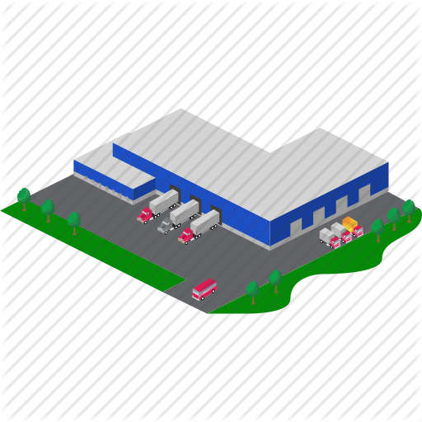
Special economic zones
FTP-2015
1965: Export processing zone @Kandla, Gujarat
2005: SEZ Act
SEZ Bottom-line: Export promotion through tax incentive.

Slide 75
SEZ has benefited India
FTP-2015
Parameter | 2006 | 2014
Exports | 22k | 5 lakh crores
Investment | 4k | 4 lakh crores
Jobs | 1.3 lakh | 13 lakh

Slide 76
SEZ improve following
FTP-2015
Automated repeat clearances to import of raw material, export of finished goods.
Develop world class infra. With upstream, downstream, road, rail and port connectivity.

Slide 77
Export units
FTP-2015
EXPORT ORIENTED UNITS (EOUs),
ELECTRONICS HARDWARE TECHNOLOGY PARKS (EHTPs),
SOFTWARE TECHNOLOGY PARKS (STPs)
BIO-TECHNOLOGY PARKS (BTPs)

Slide 78
Export units
FTP-2015
Can import raw material /components /machinery @0% custom duty. Condition- must export back.
Faster clearance to their (15 days)
Don't need industrial license to produce items reserved for SSI sector.
Don't need to furnish bank guarantee while importing.
100% FDI automatic route

Slide 79

Transport infra.
Support infra.
Road connectivity to ports
rail heads
Airport
More under L7/P1.pptx
Common packaging, labelling centres
More quality testing labs
More warehouses
More cold storages for pharma and perishables

Slide 80
Boost exports, reduce rationalize imports
Scrips & schemes
Ease of Doing
Infra.
Taxes
CVD
Dumping
MEIS/SEIS
EPCG
Niryat Bandhu
Inspection
E-Gov.
Status Holder
SEZ
Export houses
TEE, ASIDE

Slide 81

TEE (Existing)
Infrastructure
Towns of Export Excellence (TEE)
Agro, fisheries, handicraft: 150 crore exports
Others: 750 crore
Union funding for marketing, capacity building and technological services.
Common Service Providers
New proposed: Vishakhapattanam and Bhimavaram @Andra

Slide 82
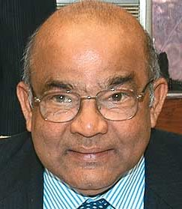
ASIDE
Infrastructure
Assistance to States for Developing Export Infrastructure and Allied Activities
By Department of Commerce
Help States to fill infrastructure gaps with this money
ASIDE allocation ▼ in Budget 2015
Reason: 14th FC’s 42% devolution (L4/P3.pptx)
FTP-2015: restructure ASIDE, Strengthen SEZ

Slide 85
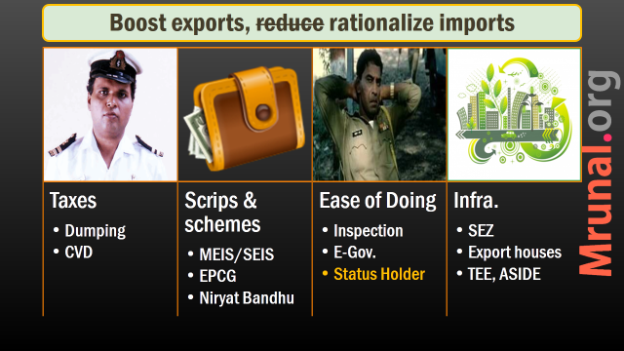
Next
Exchange rates
Forex reserve

